Slide 1
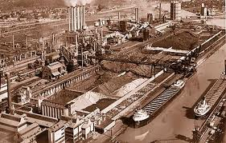
H Ford Model T “any color you want….”
Ford changes the face of modern manufacturing
$5 dollars day
40 hour week
Moving assembly line, interchangeable parts
Hired anyone, but they had to behave. To get the $5
This method of production brought higher wages, increased production, and greater opportunities but the men became as machines
Ford River Rouge plant ca. 1932

Slide 2
Scientific Management
Fredrick Taylor felt you analyze each operation
break it down into simplest movements to create efficiencies and profit
Resisted at first went against long established practices.
The auto industry first to implement.
Gives rise to White collar workforce, clerks managers , sales etc.

Slide 3
Sales and Advertising
Both employments increase drastically
Will be extremely important to business
Men still rule the workplace in these arenas

Slide 4
Women in the workforce
They will explode in the white collar clerical area during the 1920’s, typing, clerks, cashiers
Workplace was still segregated with men earning more and greater opportunities

