Slide 1
The Congress
Chapter 10
Section 2

Slide 2
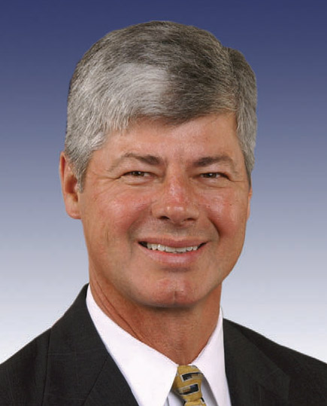
Members of Congress:
Most members of congress are middle-aged men (around 52-53 years old)
Nearly half of them are lawyers
Congressional pay is $174,000 per year
Seniority important (how committee chairs are chosen-longest serving member

Slide 3
Members of Congress:
The way a congressperson votes can be influenced by
Their constituents’ views
Their party membership
Their personal views
Over 90% of incumbents are re-elected every election
Ability to raise money
People recognize their name
http://www.colbertnation.com/the-colbert-report-videos/421159/november-12-2012/colbert-super-pac-shh----karl-rove---jon-stewart Colbert PAC

Slide 4
Gerrymandering
Deliberately drawing a congressional district to the advantage of one party or the other
http://pjmedia.com/zombie/2010/11/11/the-top-ten-most-gerrymandered-congressional-districts-in-the-united-states/
http://www.cnn.com/2011/11/18/politics/gerrymandering

Slide 5
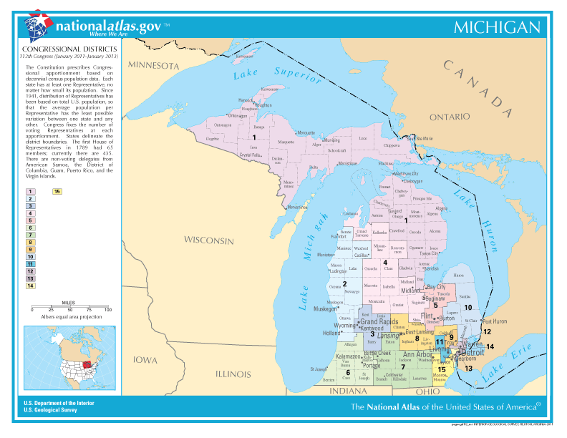

Slide 6
Congressional Staff:
Personal Staff: Staff who work directly for a congressperson
Committee Staff: Staff who work for a specific committee
Huge increases in staffing, attributed to
Growing complexity of lawmaking (ADA, environmental laws, trade agreements, etc.)
Demands that are placed on lawmakers by constituents
It helps them get re-elected

Slide 7
http://www.colbertnation.com/the-colbert-report-videos/421160/november-12-2012/colbert-super-pac-shh----secret-second-501c4---trevor-potter
Colbert keep the money

Slide 8
Congressional Staff:
Administrative Assistants: Take care of the office, set appointments, answer phones, etc.
Legislative Assistants: Make sure the congressperson is up on current issues and is informed about pending legislation
Caseworkers: Take care of dealing with constituents (social security, NIMBY issues, etc.)
Congressional Budget Office (CBO): Studies the President’s budget & does counter studies to use for and against him
General Accounting Office (GAO): keeps track of congressional spending, reviews finances
General Procurement Office (GPO): Prints everything, congressional records, bills, etc.

Slide 9
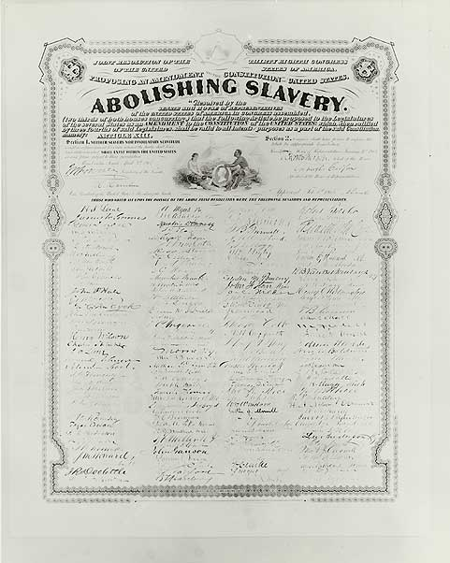
How a Bill Becomes a Law:
A bill is introduced by dropping it into the “hopper”
This can only be done by a member of congress
Concurrent Resolutions: Do not have the force of law, are just used to make a statement
Joint Resolutions: Have the force of law and require the President’s approval
https://www.youtube.com/watch?v=tyeJ55o3El0

Slide 10
How a Bill Becomes a Law:
In both the House & the Senate:
A bill is introduced & assigned to a committee
The bill is assigned to a subcommittee & then usually goes back to the main committee for approval
After committee approval, House bills usually go to the Rules committee, where rules are set for debating the bill on the floor
The bill then goes to the Committee of the Whole for further discussion & revision
Finally, the bill goes to the House floor for a highly restricted debate (amendments are offered & the entire house votes on the bill)

Slide 11
How a Bill Becomes a Law:
The Senate has no Rules Committee or Committee of a Whole
Once a bill gets committee approval in the Senate, it goes right to the Senate floor for debate
Debate in the Senate is almost completely unrestricted, anyone as long as they want
It’s this that allows for a “filibuster” which is to talk until the opposition decides to change or abandon their position
Can be stopped by a vote of cloture (requiring 60 votes)

Slide 12
How a Bill Becomes a Law:
The bill then goes to a conference committee (if necessary) where both houses work out differences in the bills
The compromise bill then goes back to the House & Senate for a vote
If it passes this, it goes to the President for approval or veto
If vetoed, it can be overridden by a 2/3 vote of both houses

