Slide 1
The Presidency
Chapter 12
Section 1

Slide 2
The Presidency:
Article 2 establishes the office of the President (executive branch)
Must be 35 years old
Must be a natural born citizen
Must be a resident of the U.S. for at least 14 years
Makes over $400,000 per year
Also has many perks: Air Force One, free room & board, etc.

Slide 3
The Presidency:
Presidents can serve 2, 4-year terms
Tradition started by George Washington
Franklin Roosevelt was the only person to serve more than 2 terms elected four times
After he died in office, the 22nd Amendment officially limited the presidency to 2 terms

Slide 4
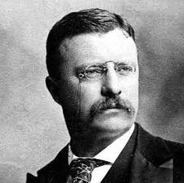
Kennedy youngest ever elected 43
Teddy Roosevelt youngest to serve 42
With the assassination of William McKinley

Slide 5
The Presidency: Electoral College
The president is NOT elected by a direct, popular vote, but by electors in the electoral college
538 people in the electoral college
Each state has electoral votes equal to their number of representatives (plus 2 senators)
CA has the most (55)

Slide 6
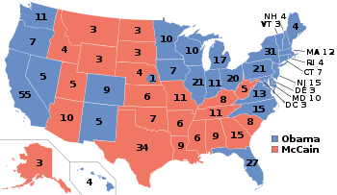

Slide 7
http://www.history.com/videos/the-electoral-college#the-electoral-college The4 electoral college
http://www.history.com/videos/the-electoral-college#transfer-of-power
Transfer of power

Slide 9
The Presidency: Electoral College
The electoral college is a winner-takes-all system
If a candidate wins the popular vote of a state by even one vote, they get all the electoral votes
If a majority of votes (270 or more) is not reached by a candidate, the house of representatives chooses the president
Critics say:
Gives more power to small states than they should have (if the vote goes to the house, each state gets one vote)
Person who wins the popular vote may not win the election (like in 2000)
You can win only eleven states and still win the presidency California

Slide 10
Caucus System
http://www.youtube.com/watch?v=NxZYwcoBPhA
Iowa is the first state in the union to hold a caucus or primary

Slide 11
Presidential Succession:
Presidential Succession Act of 1947 says that:
The Vice President takes over
Next is Speaker of the House
President Pro-Tempore of the Senate
Secretary of State & other cabinet officers in order of succession
Secretary of Treasury
Secretary of Defense
Attorney General

Slide 12
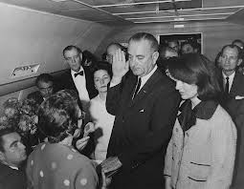
The 25th amendment
LBJ takes the oath of office after the assassination of JFK this is the reason for the passage of the 25th amendment to the constitution

Slide 13
http://www.youtube.com/watch?v=LD_wUNb0cw8
President entering State of union

Slide 14
What Happens if they all go down

Slide 16
Presidential Succession:
25th Amendment (Presidential Disability & Vice President) says:
If there is a vacancy in the vice presidency, the president selects a nominee (must be confirmed by a majority of both houses)
If people feel the president is unable to perform his duties, the VP and a majority of the cabinet, with 2/3 approval of both houses can make the VP the President
President can declare himself unfit for service

