Slide 1
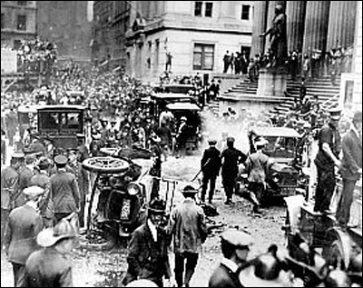
Chapter 11 Section 1 The Rise of Radicalism
After the end of WWI, and the success of the Russian revolution comes a growing radicalism bombing s and violence in the US
Hatred of Germans turns to hatred of commies and immigrants and anarchists (people who believe in no government)
Fear of communism leads the First Red Scare. 1919-20
http://www.youtube.com/watch?v=7xjIK3rkX6M
Mitchell Palmer Attorney General of the US is pushed into action. He will arrest and try to deport thousands of “anti-american” people.
Palmer Raids abused peoples rights. While many are for them initially, the tactics will turn people against them, and they will end
Wall Street will be bombed 1920 killing 30 people
Wall Street 1920

Slide 2
http://www.youtube.com/watch?v=4KopNWohK_M wall street

Slide 3
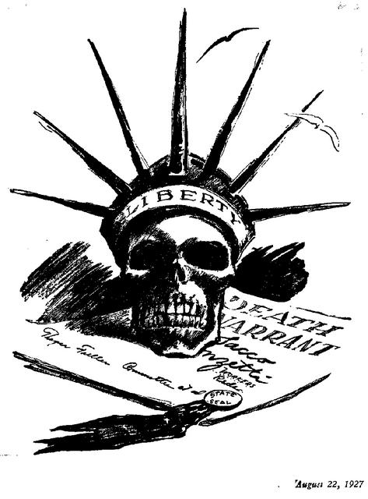
1. What popular American icon is represented? 2. What is the symbolism of the cartoon? 3. What court case caused this cartoon to be drawn

Slide 4
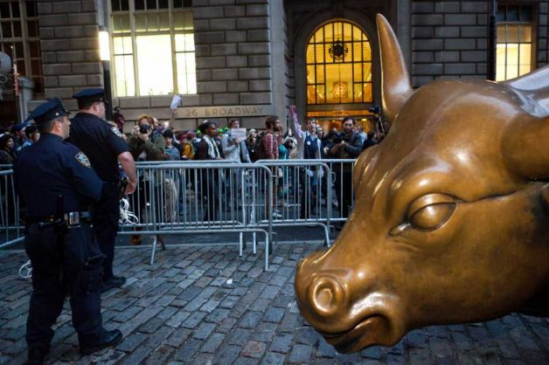
Occupy Wall Street 2011

Slide 5
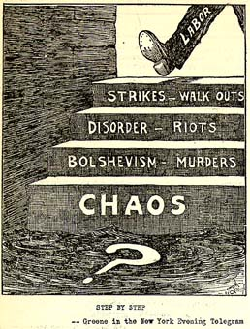
Labor Unrest
In 1919 there will be over 3,900 labor strikes. coal, steel, police etc.
The business owners and media will portray them as being a red revolution and un-american
There were a few commies in the movement, most wanted better pay
and conditions
This will contribute to the
Fear of the Red scare

Slide 6
Into the fire
April 15, 1920 a guard is robbed shot and killed.
Two Italian anarchist immigrants will be arrested .
In a controversial and flawed trial. The conviction and eventual execution of Nicola Sacco and Bartolommeo Vanzetti will cause demonstrations and riots around the world
Opinions still vary today but many people feel that Sacco was probably guilty. Vanzetti probably only after the fact

Slide 7
https://www.youtube.com/watch?v=NaOKNK0yoDo

Slide 8
The Great Migration
Life for many blacks had not changed in the south after the civil war
WWI veterans saw a different way in Europe.
Between 1916 and 1902 over half a million blacks will leave the south and go north
Migration will continue until 1930
Less discrimination
Better pay
http://www.youtube.com/watch?v=Cxi6SN2d51w

Slide 9
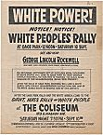
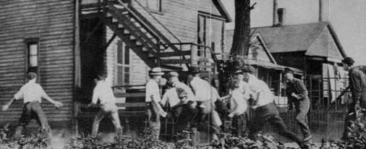
For Every Action …
Whites don’t like blacks coming in and taking jobs and gaining power
Riots will break out in cities all
The US
Chicago July 1919 will be the
Worst 15 white 23 blacks dead
President Wilson will have to
Call in federal troops

Slide 10
……There is a Reaction
Marcus Garvey will promise to be the savior of blacks with the Back to Africa movement
Self help, black pride he forms the Universal Negro Improvement Association.
Blacks should move “Back to Africa” and start their own country.
Eventually gets convicted for mail fraud for taking investors money and the expedition falls apart. He was a Great influence on people including Malcolm X’s parents

Slide 11
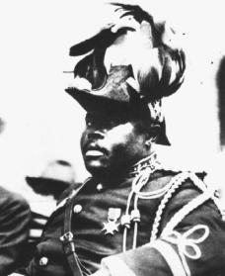
Marcus Garvey
http://www.youtube.com/watch?v=R-XjloOKl60

Slide 12
More Progressivism
18th amendment to the constitution will come in 1920. Makes sale of alcohol illegal
Ratified in 1919 but text says it will start one year from the day of registration
Volstead Act 1919 sets about the way to enforce the amendment

Slide 13
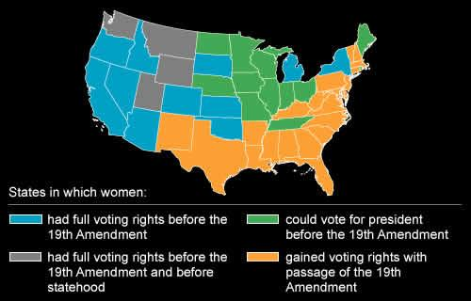
Suffrage
Progressives want the right to vote for women, thinking they will support their reforms
Women's role in WWI give them a sense of entitlement
19th amendment passed in 1920 giving universal suffrage

Slide 14
Decline of progressivism
A hostile supreme court will declare many of the progressive laws passed unconstitutional
Many people will lose faith in government to solve problems after the brutality of WWI
Turmoil of post war years also weaken the movement

