Slide 1
Comparative Economic & Political Systems
Chapter 18
Section 2

Slide 2
Comparative Political Systems: Democratic
Measures of a democracy:
Political Participation by Citizens: Participation comes from individuals and groups apart from the government
Freedom of Communication & Speech: If the government owns all the news outlets, democracy is limited
Recruitment of Political Leaders: Leaders don’t all come from the same families, schools/colleges or the same part of the country
Affect of Citizen Participation: Citizens have a high degree of political knowledge & participation (influence actually impacts the government)

Slide 3
Comparative Political Systems: Democratic
Contd.
Rule of Law, not Individuals: Same laws govern everyone equally
Competitive Popular Elections: Elections are fair and give people a real choice between candidates

Slide 4
Comparative Political Systems: Authoritarian
Measure of authoritarianism:
Citizens as Subjects: Citizens have little influence on the policies made by government, act only as subjects (obey)
Restrictions on Communications & Speech: Open criticism of the system is prohibited, news outlets are censored
Narrow Recruitment of Political Leaders: Leaders are narrowly selected in a way that eliminates most citizens from consideration

Slide 5
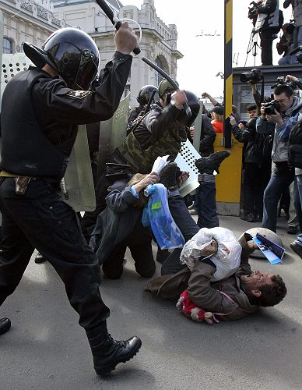
Comparative Political Systems: Authoritarian
Contd.
Rule of Individuals, not Law: Authoritarian rulers make their own rules and decisions about policies, these decisions not bound by law
No Competitive Elections: May have no election process at all (if they do, citizens don’t have a real choice of candidates)

