Slide 1
The Bill of Rights
Chapter 3
Section 3

Slide 2
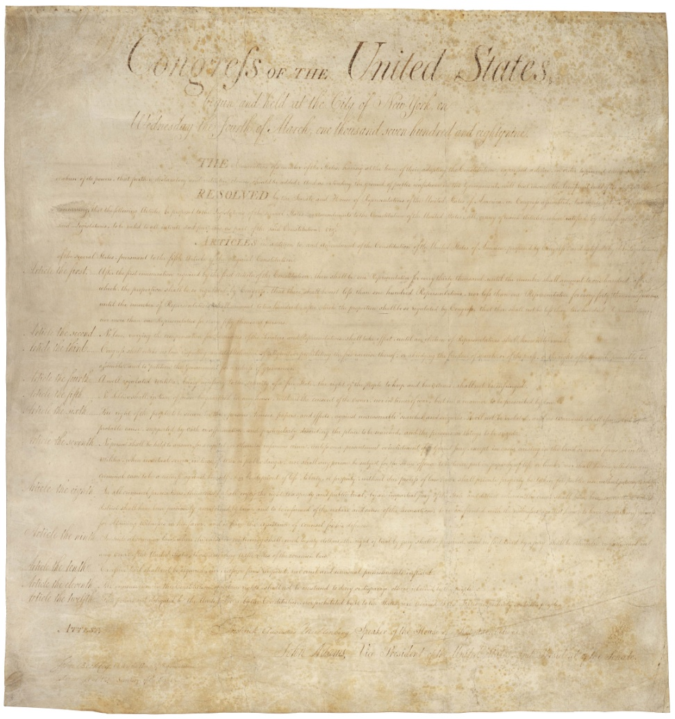
The Bill of Rights:
The constitution was a limitation on the government (not the individual)
Designed to protect your freedoms and to ensure your freedom and liberty
The Bill of Rights is aimed explicitly at protecting your rights as citizens

Slide 3
Bill of Rights: Preamble
Congress of the United States begun and held at the City of New-York, on Wednesday the fourth of March, one thousand seven hundred and eighty nine
THE Conventions of a number of the States, having at the time of their adopting the Constitution, expressed a desire, in order to prevent misconstruction or abuse of its powers, that further declaratory and restrictive clauses should be added: And as extending the ground of public confidence in the Government, will best ensure the beneficent starts of its institution.
RESOLVED by the Senate and House of Representatives of the United States of America, in Congress assembled, two thirds of both Houses concurring, that the following Articles be proposed to the Legislatures of the several States, as amendments to the Constitution of the United States, all, or any of which Articles, when ratified by three fourths of the said Legislatures, to be valid to all intents and purposes, as part of the said Constitution; viz.
ARTICLES in addition to, and Amendment of the Constitution of the United States of America, proposed by Congress, and ratified by the Legislatures of the several States, pursuant to the fifth Article of the original Constitution.

Slide 4
First Amendment:
Congress shall make no law respecting an establishment of religion, or prohibiting the free exercise thereof; or abridging the freedom of speech, or of the press; or the right of the people peaceably to assemble, and to petition the Government for a redress of grievances.
Freedom of the press
Freedom of religion
Freedom of speech
Freedom to petition the government

Slide 5
Second & Third Amendments:
2nd Amendment: A well regulated Militia, being necessary to the security of a free State, the right of the People to keep and bear Arms, shall not be infringed.
Right to bear arms
3rd Amendment: No Soldier shall, in time of peace be quartered in any house, without the consent of the Owner, nor in time of war, but in a manner to be prescribed by law.
Government can’t force you to keep troops in your home

Slide 6
4th, 5th, 6th, 7th, 8th Amendments:
Guarantee the rights of the accused either in criminal or civil cases
Protection against unreasonable search & seizures (4th)
Due process, double jeopardy, self-incrimination & eminent domain (5th)
Trial by jury, speedy trail, public trial, right to counsel (6th)
Civil trial by jury (7th)
Prohibits excessive bail, & cruel & unusual punishment (8th)

Slide 7
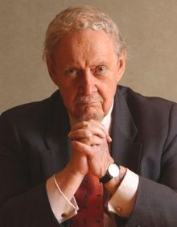
9th & 10th Amendments:
9th Amendment: The enumeration in the Constitution, of certain rights, shall not be construed to deny or disparage others retained by the people.
Rights not named specifically, still exist
If it’s not named, the people retain it

Slide 8
10th Amendment: The powers not delegated to the United States by the Constitution, nor prohibited by it to the States, are reserved to the States respectively, or to the people. Powers assigned to the states and to the people Reserved Powers

Slide 9
Informal Changes to the Constitution:
Not so much changes as “clarifications” of governmental powers/roles
Legislative Actions: Laws passed that spell out and add to the constitution’s provisions (taxes) (impeachment)
Executive Actions: The way in which the president carries out his duties shapes our interpretations of the document
Judicial Interpretations: Most influential in interpreting the constitution when disputes arise.
Marbury v. Madison greatly expanded the power of the court (judicial review)

