Slide 1
Federalism
Chapter 4
Section 1

Slide 2
Federalism:
Founders did not explicitly layer state & federal government
Constitution separates state & federal powers but recognizes the existence of “shared powers”
The mere existence of national and state governments does not make for federalism
Key ingredient is power that is divided & shared between the two

Slide 3
Interpretations of Federalism:
Dual Federalism:
Prevalent the first 100 years (or so) after the revolution
Constitution gives limited powers to the national government, leaving most power to the states
Each level of government dominates its own “sphere”
Cooperative Federalism:
Defines federalism as providing goods/services to the people, thus requiring cooperation amongst various levels of government
New Federalism:
Emphasizes shrinking the size & responsibility of the national government & returning more power to the states

Slide 4
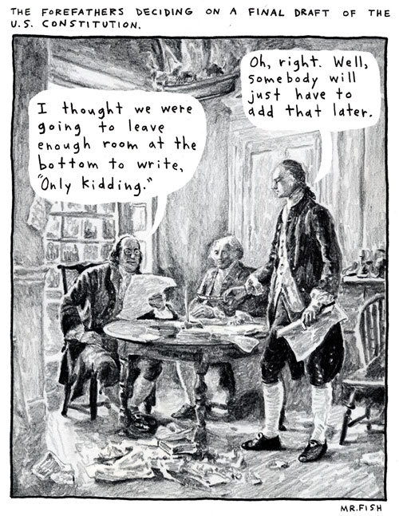
Powers of the National Government:
Constitution gives three types of powers to the national government
Delegated Powers:
Or expressed powers, those specifically written in the constitution (collect taxes, coin money, regulate commerce, armed forces, declaring war, granting patents & copywrites)

Slide 5
Powers of the National Government:
Implied Powers:
“Elastic clause” gives congress powers to make all laws which shall be necessary and proper for carrying into execution the foregoing powers
Inherent Powers:
Used in foreign affairs
Don’t depend on specific clauses of the constitution
Powers to acquire territory, recognized foreign states, set immigration policy, protect the U.S. from rebellion

Slide 6
Powers of the States:
Reserved Powers:
Powers held by the states that are not delegated to the national government nor denied to the states
Not specifically listed, but guaranteed by the 10th Amendment as “reserved to the states respectively, or to the people”
Powers to establish local government, conduct elections, regulating trade within a state and ratifying amendments to the constitution

Slide 7
Other Powers:
Concurrent Powers:
Powers held by both the national and state governments
Not granted exclusively to the federal government nor reserved for the states
Include levying & collecting taxes, separate court systems, making & enforcing laws, borrowing money
Prohibited Powers:
Powers denied to the national government, state government or both
Federal government prohibited from taxing exports & interfering with the states exercise of their rights
State government prohibited from making treaties with foreign governments, coining money or engaging in war

Slide 8
Federal Responsibilities:
Guarantee a republican form of government to every state in the union
Keep order and protect the states from “domestic insurrection”
Shay’s rebellion anyone?
Admission of new states
Establish standards for states to follow (in return for federal monies)

Slide 9
State Responsibilities:
Can be called upon to organize a militia in times of need
Governor of a state can activate the “National Guard” in times of natural disasters or emergencies
Responsible for the elections of all public officials, including national senators, representatives and the president
Also responsible for voter registration & polling locations
Determine congressional districts
Ratify amendments to the constitution

Slide 10
State Responsibilities to Each Other:
Full Faith & Credit Clause:
Each state must give full faith & credit to the public acts, records and civil judicial proceedings of every other state
Extradition prevents criminals for escaping prosecution (all criminal laws are state laws) by crossing state lines
People visiting other states have all the rights of state residents
Exceptions include voting & tuition rates

