Slide 1
Chapter 9 limits to progessivism
TR and his Square Deal platform challenges Taft a republican by running as a third party candidate of the Bull Moose Party
Woodrow Wilson (democrat) wins
He calls his programs the New Freedom
Reduce Tariffs,
Bank reform creation of the creature of Jekyl Island the federal reserve. Bank, which is neither.
Regulate trusts.

Slide 2
President Taft continues reform
Prosecutes twice as many trusts
Expands national forests
Supports mine safety

Slide 3
Drastic Change 1913
Federal Reserve Bank
16th Amendment to constitution Income tax
17th amendment direct election of Senators
19th amendment originally proposed by Susan B. Anthony one of the greats of the Suffrage movement and pressed on by Carrie Chapman Catt gives women the vote 1920

Slide 4
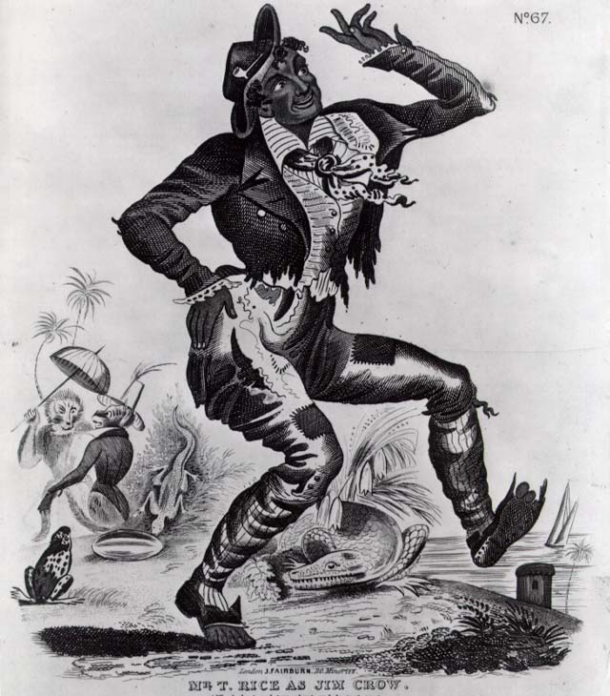
Blacks have few benefits from progressive reform
Segregation is the law of the land in the south.
The supreme court agrees
In the landmark decision
Plessy v Ferguson 1898
Which says separate
Facilities for blacks and
whites are equal

Slide 5
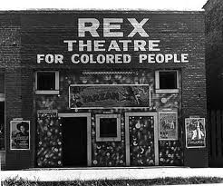
Without Sanctuary

Slide 6
http://withoutsanctuary.org/

Slide 7
Plight of African Americans
Booker Taliaferro (T) Washington sets up the Tuskegee Institute to help educate blacks
Accommodation-Washington’s idea of accepting Jim Crow and emphasizing economic equality
W.E. Debois another prominent African American . First black gradate of Harvard, helped found NAACP argued equality at once. Get the vote and end discrimination.

Slide 8
Melting Pot
Many Like TR felt that Nativism ( American born people and culture) was superior to immigrant
“Nineteenth-century democracy needs no more complete vindication for its existence than the fact that it has kept for the white race the best portions of the new world’s surface.” TR
Don’t let anyone in but Anglo-Saxon people.

Slide 9
Many will reject the capitalist movement.
Eugene Debs leading Socialist in US helps found the International Workers of the World The Wobblies
Will run for the presidency several times, and even from Jail

