Slide 1
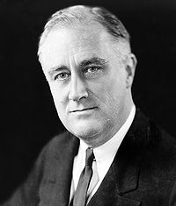
FDR and the New Deal

Slide 2
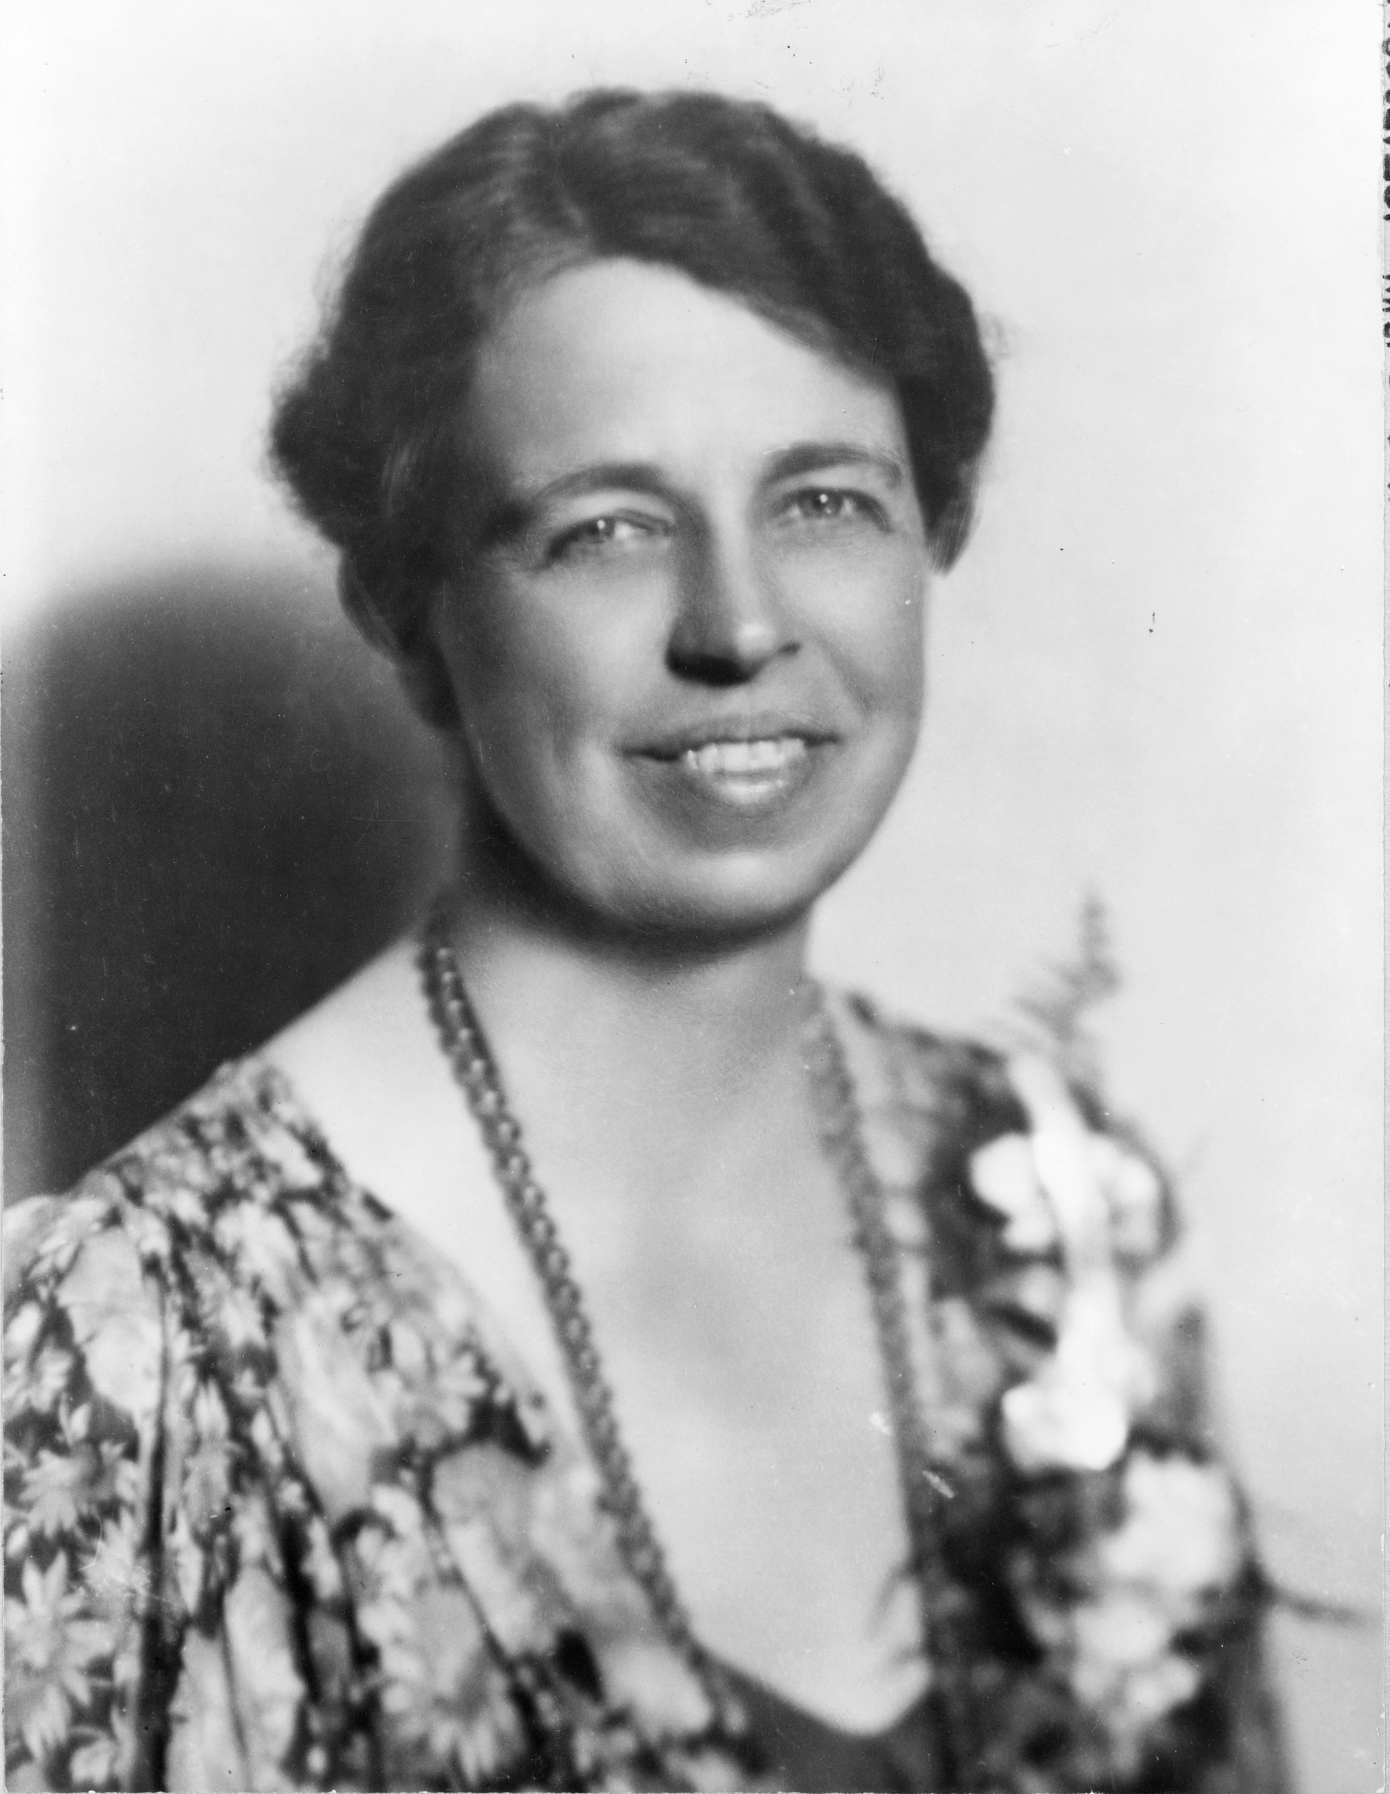
Early Years
With the election of 1932 FDR will become the only person ever elected president more than twice. Married to Cousin Eleanor at the
age of 23
He enters the political arena
on the vice presidential ticket
in 1920 as a democrat.
We all know what happened
that election
Eleanor Roosevelt

Slide 3
He serves as Assistant Secretary of navy and in 1921 is paralyzed from Polio for the remainder of his life.
But not really he probably had Guillain-Barre an auto immune disease that attacks healthy tissue after an infection or surgery
He will become the governor of New York twice and receive praise for his statewide relief efforts
Contagious optimism and attacking Hoover for huge deficits and big government FDR wins big in 1932.

Slide 4
FDRs 32 election re-aligns American politics. Pulling in Blacks, ethnic Americans into the democratic fold for the next four elections.
FDR refuses to deal with Hoover after the election.
Michigan will start closing banks early in ’33 this will increase the panic to a nationwide crisis phenomenon.
http://www.history.com/topics/us-presidents/franklin-d-roosevelt/videos/inaugural-address-franklin-d-roosevelt

Slide 7
First 100 days. AKA First New Deal
100 days are a flurry of activity
FDR calls for special session of congress and Bank Holiday to stem the closures. Solid banks can the re-open, with weaker ones getting help.
Relief, Recovery, Reform comes to full swing

Slide 8
Relief
FERA Federal Emergency Relief Administration immediately gets $ 500,000,000 to relief agencies to put people on the public dole as it was called.
This goes to the states to make sure people have enough money to survive.

Slide 9
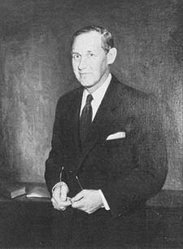
Harry Hopkins
Hopkins was FDR’s right hand man in charge of administering much of the new deal.

Slide 10
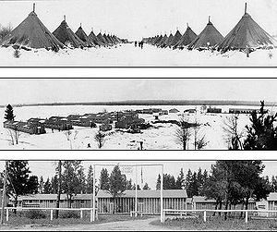
Recovery-the Alphabet Armies
Now FDR wanted to put people back to work
CCC Civilian Conservation Corps-
environmental programs.
Planting forests
building outdoor
projects for $30/month
http://www.minews26.com/content/?p=28050

Slide 11
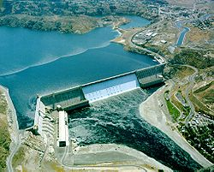
PWA Public Works Administration- $3.3 billion Built schools, dams, post offices, roads were the mainstay
Grand Coulee Dam Wash. St.

Slide 12
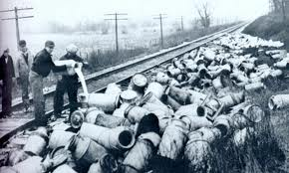
AAA
Agricultural Adjustment Act Designed to get famers back on their feet. Paid not to grow crops or raise certain livestock. subsidies
Plowing under crops and killing animals when people were in need of food seemed callous

Slide 13
More Recovery
NRA National Recovery Administration-set standards for work conditions, wages, hours, union bargaining.
Displaying the poster at
The right showed that you were a
member. Put a lot of pressure on
Businesses to join

Slide 14
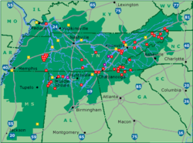
TVA
Tennessee Valley Authority- A series of dams Designed to bring electricity as well as tourism for the lakes that would be to the Tennessee valley tributary system
Pros: Cheap electricity to rural areas help control flooding
Cons: flooded peoples homes, gov’t subsidized power undercut other producers
https://www.youtube.com/watch?v=zaI7GsxdmvM

Slide 15
Reform Laws
Truth in Securities laws- eliminate fraud in stock market. Penalties for lying to investors
Glass- Steagall Act- banks can’t invest in stock market
FDIC- Federal Deposit Insurance Corporation- part of GS act insured deposits up to $2,500 now up to $250,000

Slide 16
First New Deal
FDR Proposed 15 bills all passed with little change. Some what easy in a Democratic congress

Slide 17
FDR’s Style
Calm and collected, positive
Fireside chats are a masterful usage of the new technology
https://www.youtube.com/watch?v=jt9f-MZX-58

Slide 18
Eleanor
Eleanor was very active in politics joining various organizations, League of Women's Voters etc
Kept a pulse on the plight of the nation keeping husband informed.
Had her own advisors and gave he own press conferences to female reporters
Kind face of the administration.

