Slide 1
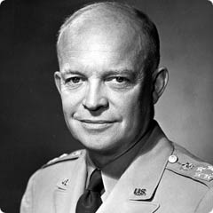
I Like IKE
In an age of uncertainty, Communist
advances, war in Korea people want the reassuring, calm manner and smile of a father figure.
Ikes opponent Is Adlai Stevenson is deemed a egg head. Not as likeable as Ike, and he's the same party as Truman
Ike picks anticommunist Senator Richard Nixon to be his running mate.

Slide 2
Tricky Dick
Nixon will become embroiled in a scandal about a secret slush fund from contributors and may be thrown off the ticket
They buy time on TV and radio and he defends himself with the infamous Checkers Speech.
http://www.youtube.com/watch?v=XhQD2UFCIbY
75 to 1 in favor of Nixon
They continue to hammer on the democrats for scandal. Ike promises to go to Korea and end the war.
Ike and Nixon win the Whitehouse

Slide 3
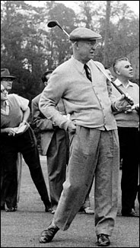
Ike Presidency
Ike believes in consensus building “ no one has a monopoly on the truth”
Feels America should be run with business like efficiency. Appoints business leaders to cabinet.
Gets Atomic Energy Act passed beginning of building Nuclear Power plants.

Slide 4
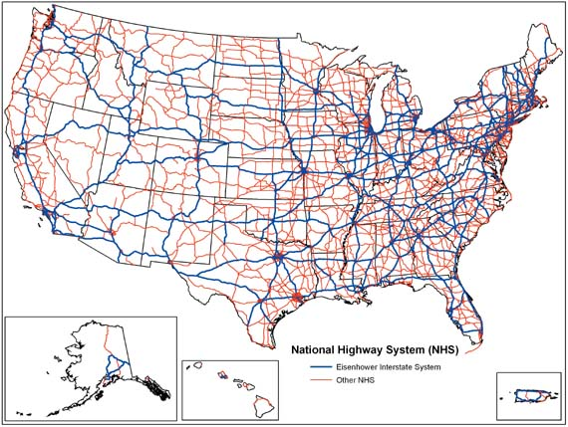
Re-election
Ike gets re-elected running against Adlai Stevenson again. Less energetic but people still liked him
Begins the interstate Highway System
Over 42,000 miles
Cost six times the estimate

Slide 5
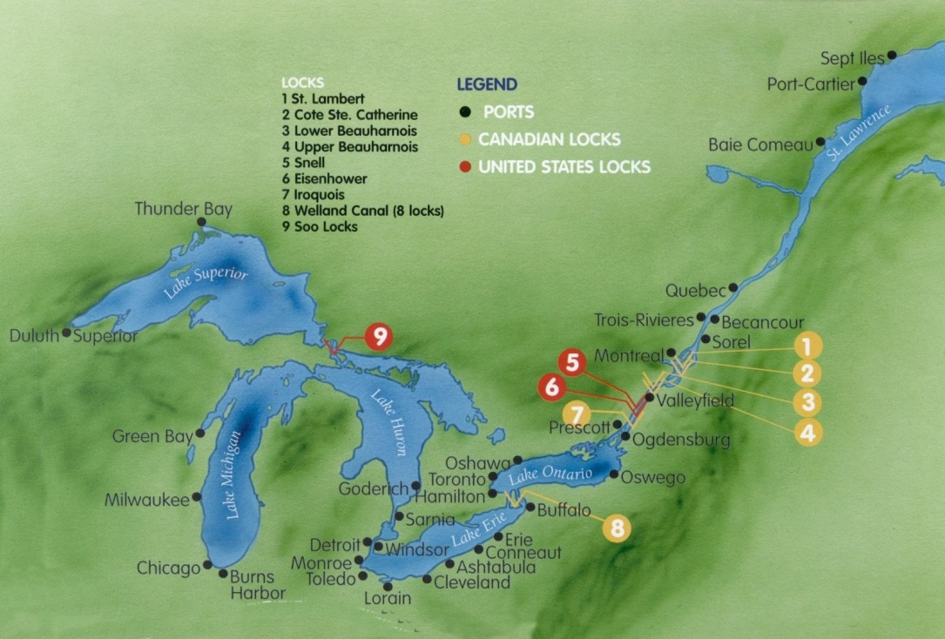
Also created St Lawrence Seaway system of locks connecting great lakes to Atlantic

Slide 6
Ikes Legacy
Ike has problems with the “cold war” heating up.
Sputnik embarrasses us.
http://www.youtube.com/watch?v=CHaJDuq6tBM
Cuba goes commie(more on that later)
Social security extended.

Slide 7
Foreign Policy
CIA led coups in Iran, Guatemala, the Belgian Congo, and the beginning of our involvement in Vietnam. ( more on that later also.) and they became the modus operandi of the US after that.
MAD Mutually assured destruction comes of age
Soon after the election of 1960 JFK vs. Richard Nixon
( more on that later also)

