Slide 1
Origins of the Cold War… they’re a bunch of commies
Cold War: bitter state of conflict between the US and USSR no direct warfare. We do it in third world countries
“Allies” of convenience during the war.

Slide 2
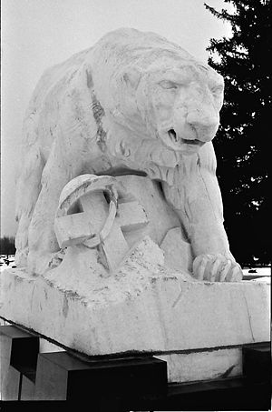
Reasons we hated each other Practical
Refused to recognize Soviet Union after 1917 revolution. We also invaded them 1918-19
Russians signed Non-Aggression
Pact with Nazis 1939
Russian refusal to stand by Yalta
agreement and hold free elections
in eastern Europe
Allied delay in opening second
front
Monument White Chapel Cemetery
Troy Mi.

Slide 3
Practical continued
Soviets will lose over 20 million people
US kept atom bomb from soviets

Slide 4
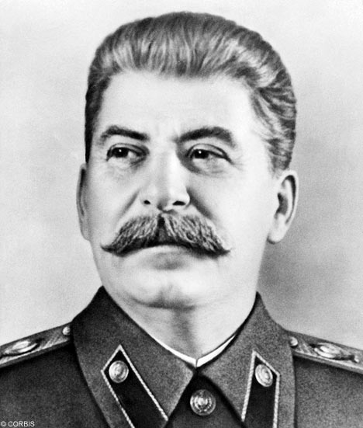
Philosophical reasons. How we viewed the world differently
We wanted free markets, capitalism and profit
Soviets are commies. Believe in no profit. No private property
Commies are atheist
Hence the under god in Pledge of allegiance
The most murderous
Man in history
Joseph Stalin

Slide 5
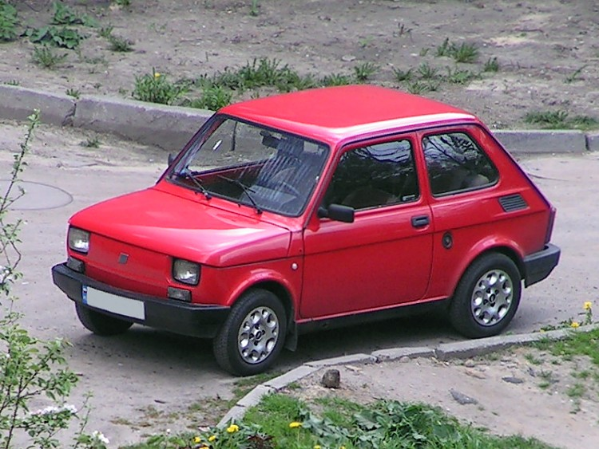
Why Communism Stinks
2 cyl Fiat 126p

Slide 6
Why America is Great

Slide 7
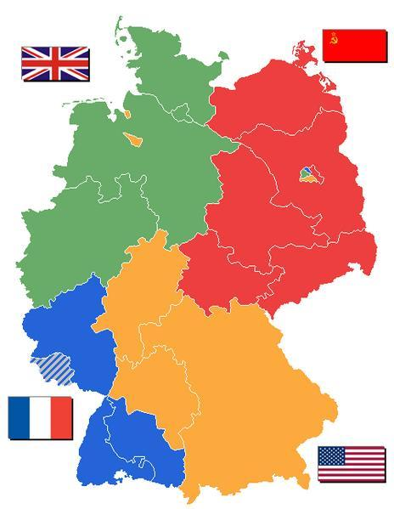
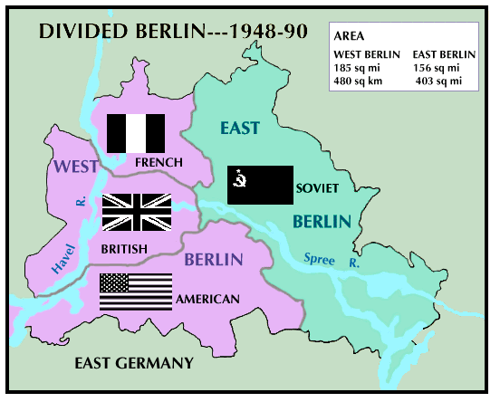
Things Happen
Germany was divided into four zones
of control after war
Same is true of Berlin
The situation continues
To deteriorate. Opinions of the USSR dramatically falls in the US.

Slide 8
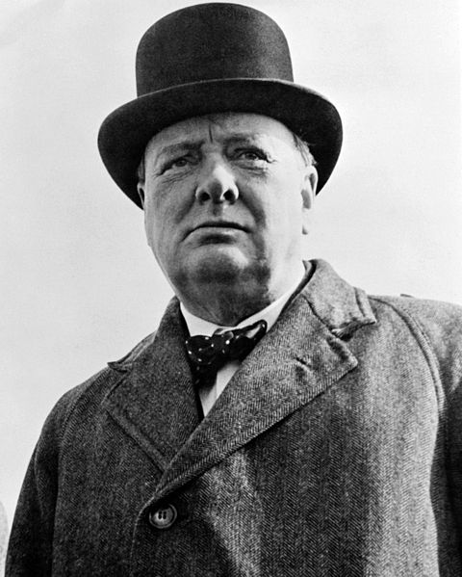
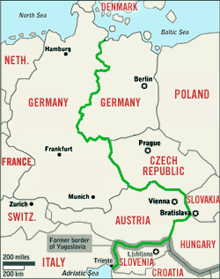
Churchill says it all
Churchill sees the future. His famous quote.
“From Stettin on the Baltic, to Trieste on the Adriatic, an Iron Curtain has descended across the continent”

Slide 9
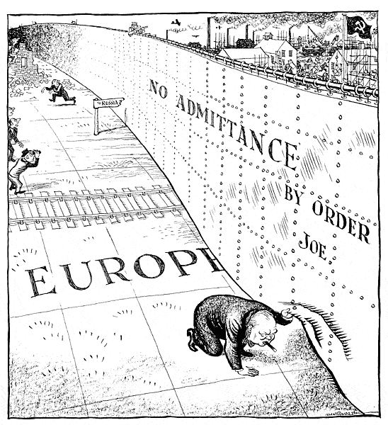

Slide 10
Churchill cont….
Behind that line lie all the capitals of the ancient states of Central and Eastern Europe. Warsaw, Berlin, Prague, Vienna, Budapest, Belgrade, Bucharest and Sofia, all these famous cities and the populations around them lie in what I must call the Soviet sphere, and all are subject in one form or another, not only to Soviet influence but to a very high and, in many cases, increasing measure of control from Moscow

Slide 11
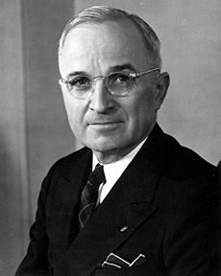
Cold War in Full Swing AKA How to beat the commie buggers
Containment policy- Remove any opportunities for the Soviet commie suckers to expand
Greece and Turkey look like they are going to go to the god less commies
Truman Doctrine: US must help all peoples resist commie subjugation $400 million military and economic aid to Greece and Turkey

Slide 12
Economic Help to the world
Marshall Plan: $13 billion in US aid to Europe to spend on US goods.
Many people disliked the idea. Wanted US out of Europe's affairs
The more a country received the slower they recovered.
And the idea wasn’t Marshalls anyways, he was Secretary of State and just then point man

Slide 13
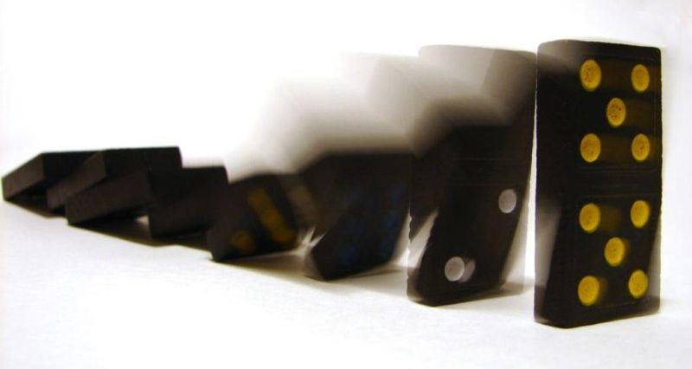
Lets play a game
Domino theory: if one country falls to communism, then the next will fall and then another like a row of dominoes

