Slide 1
Retreat from the New Deal
After WWII the economy is not doing well unemployment is high for servicemen returning
Backlash against the democrats and the New Deal
Anti communism is beginning in election of 1946 being “Red” or sympathizing with them is bad.
Richard Nixon a conservative is one of the new congressmen as republicans take control of congress

Slide 2
Cont
Reconversion- switching from wartime to peacetime economy
4.6 million workers go on strike
1951 22 amendment is passed limiting the presidents terms to no more than 2

Slide 3
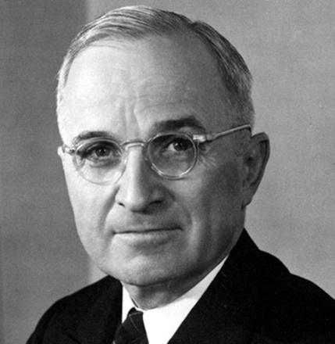
Economics
Harry Truman becomes president after death of FDR.
He lifts wage and price
controls put in place during
the war and prices go up 25%
Meat doubles in price in two weeks
Strikes break out around the country, and a backlash occurs towards unions

Slide 4
Cont.
Taft-Hartley Act curbs the power of unions.
Bans closed shops places where you had to be a union member to work
Right to work allows states to outlaw union shops where you had to be a member to work in company
Truman vetoes bill and congress overrides it. Labor is now shifting to Truman's side

Slide 5
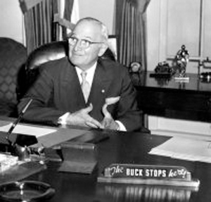
Truman
Country bumpkin who doesn’t want to be president.
Will do what he thinks is best.

Slide 6
Trouble in River City
Truman's approval rating was low. He was no FDR, faces a revolt within democrat party
His support if Civil Rights, anti-lynching laws causes the southern wing to bolt, form the Dixiecrats and run their own pres. Candidate
Republicans run Thomas E Dewey appears he has the race won…..

Slide 7
Give ‘em Hell Harry
Harry calls special session of congress urges them to pass bills to help economy.
The refuse to pass any. Now he has ammo
Does a 32,000 mile whistle-stop tour of the country.
Rails against the do nothing congress. Week of election Truman still trails by 10 points

Slide 8
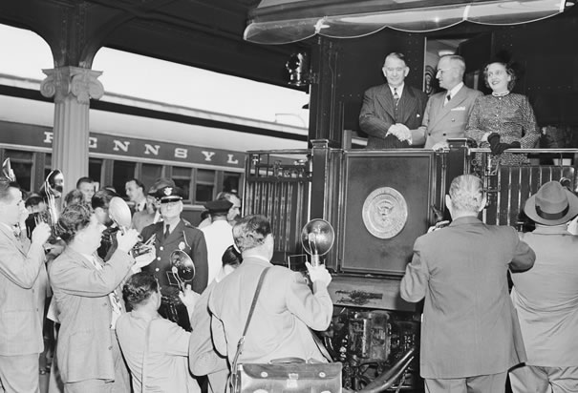
Whistle stop tour

Slide 9
Chicago Tribune gets it wrong

Slide 10
The “Fair Deal”
Harry Truman's 21 point program for getting the US going again
Extension of FDR’s New Deal
Broadened Social security
Increased minimum wage
Housing assistance
But the opposition to his program was often successful in stopping his ideas

Slide 11
The bottom
Harry victories will be overshadowed by corruption scandals, loss of China, defeat on Civil Rights, and Korean war
He leaves office with the lowest approval rating of modern presidents
Yes even G.W. Bush

